Slide 1
Architecture and Design
Software Engineering
Neil Toporski

Slide 2
1. Architecture and Design[Outline]
What is Architecture and Design in Software Engineering?
Architectural Abstraction
Advantages
Representations

Slide 3
1.1 What is Architecture and Design in Software Engineering?
Architectural design is concerned with understanding how a software system should be organized and designing the overall structure of that system.
Architectural design is the critical link between design and requirements engineering, as it identifies the main structural components in a system and the relationships between them.
The output of the architectural design process is an architectural model that describes how the system is organized as a set of communicating components.
It is generally accepted that an early stage of agile processes is to design an overall systems architecture.
Refactoring the system architecture is usually expensive because it affects so many components in the system

Slide 4
1.2 Architectural Abstraction
Architecture in the small is concerned with the architecture of individual programs. At this level, we are concerned with the way that an individual program is decomposed into components.
Architecture in the large is concerned with the architecture of complex enterprise systems that include other systems, programs, and program components. These enterprise systems are distributed over different computers, which may be owned and managed by different companies.

Slide 5
1.3 Advantages
Stakeholder communication
Architecture may be used as a focus of discussion by system stakeholders.
System analysis
Means that analysis of whether the system can meet its non-functional requirements is possible.
Large-scale reuse
The architecture may be reusable across a range of systems
Product-line architectures may be developed.

Slide 6
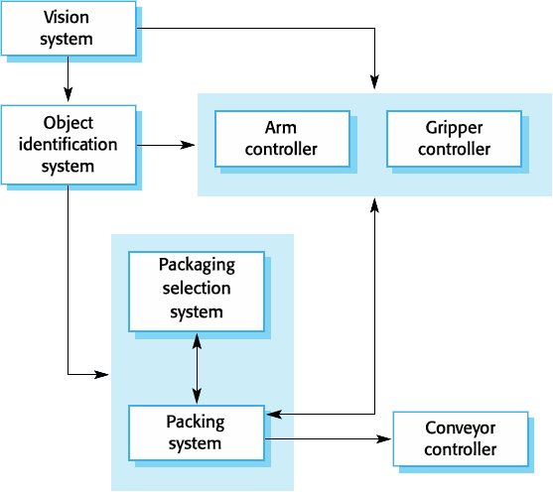
1.4 Architectural Representations
Simple, informal block diagrams showing entities and relationships are the most frequently used method for documenting software architectures.
But these have been criticized because they lack semantics, do not show the types of relationships between entities nor the visible properties of entities in the architecture.
Very abstract -do not show nature of component relationships nor externally visible properties of the sub-systems.
However, useful for communication and facilitating discussions with stakeholders and for project planning.

Slide 7
2 Architectural Views
Architectural Views
Logical View
Development View
Process View
Physical View

Slide 8
2.1 Architectural Views
Architectural design is concerned with understanding how a software system should be organized and designing the overall structure of that system.
The output of the architectural design process is an architectural model that describes how the system is organized as a set of communicating components.

Slide 9
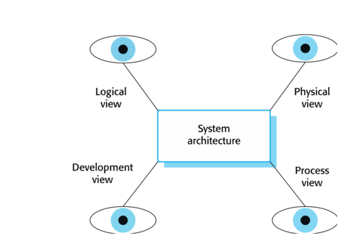
Architectural Views
A logical view, which shows the key abstractions in the system as objects or object classes.
A process view, which shows how, at run-time, the system is composed of interacting processes.
A development view, which shows how the software is decomposed for development.
A physical view, which shows the system hardware and how software components are distributed across the processors in the system.

Slide 10
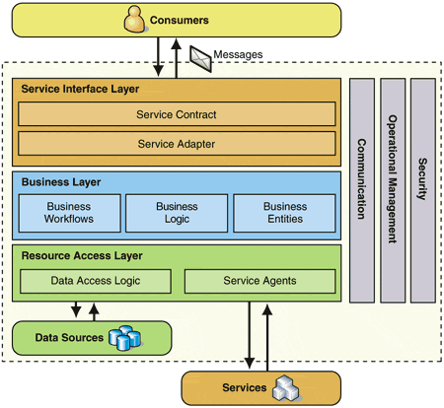
2.2 Logical View
A user should be able to retrieve paintings by location (for example, all paintings in (art galleries of) Italy). The search results returned should be sorted alphabetically according to the name of the art galleries in the location and should be links that take the user to the particular art gallery information.

Slide 11
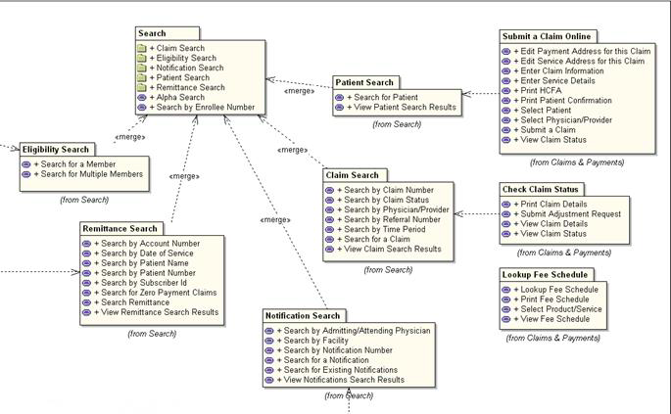
2.3 Development View
Shows how the software is decomposed for development - the breakdown of software into components

Slide 12
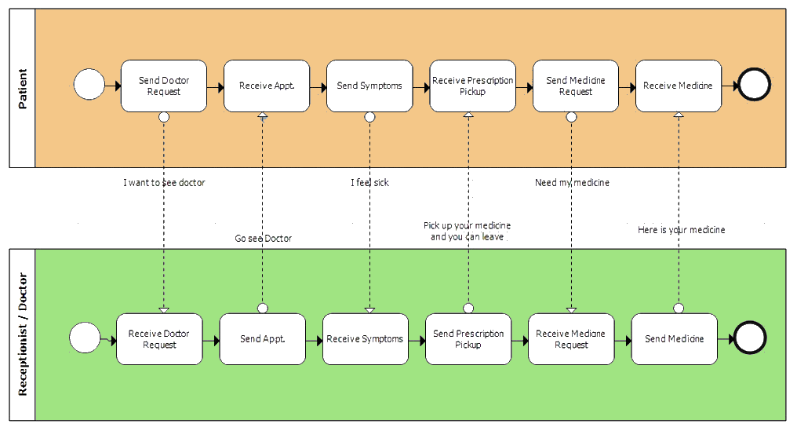
2.4 Process View
Shows how, at runtime, the system is composed of interacting processes.

Slide 13
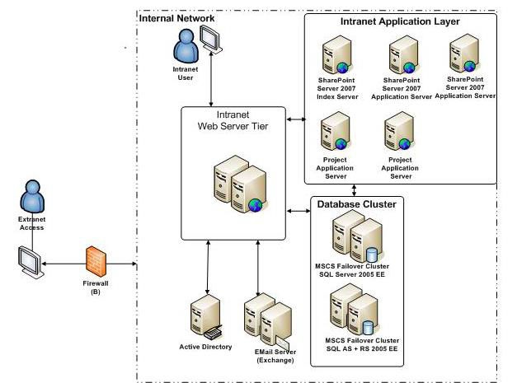
2.5 Physical View
Shows system hardware and how software components are distributed across processors.

